Slide 1
Providing Registry Services to the LGBTQ2S+ Community
C 2018

Slide 2
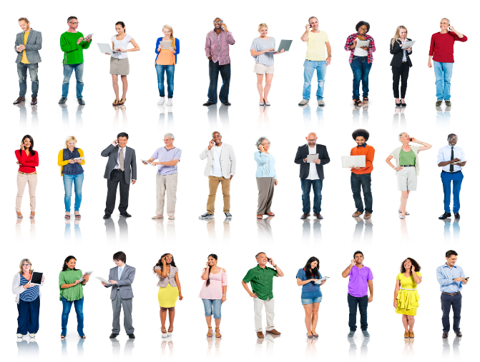
Providing Registry Services to the LGBTQ2S+ Community

Slide 3
Alberta Civil Liberties Research Centre
Established in 1982
Develop educational tools
Offer educational sessions for teachers, students and organizations across Alberta
Research and publish human rights resources for education and information
Refer the public to information and resources on human rights
Do not provide legal representation or advocacy

Slide 4
Speaker Biographies
Heather Forester has practiced law in Alberta for over 30 years. She recently acted as a Research Associate and is now a Human Rights Educator with the Alberta Civil Liberties Research Centre (ACLRC).
Melissa L. Luhtanen is Senior Legal Counsel for the Alberta Human Rights Commission.
Angela Reid has been a part of the Trans Equality Society of Alberta (TESA) for several years, focusing on legal and medical power structures that affect trans person's lives. In 2014 she was able to successfully argue for a fully self-declared Canadian passport, years before passport regulations were changed to allow this. She enjoys a wide diversity of experiences, is currently working as an electronics technologist for a major oilfield services company, and plays competitive roller derby with Calgary's All-star team and Team Alberta.
Holly Tomm was recently elected to a second annual term as a Board Member/Director and Secretary for the TESA. Holly has been an active advocate in the transgender community for several years and has made presentations to various youth groups, university classes and fundraising events on behalf of the transgender community. Along with her active participation in the promotion of
LGBTQ+ rights Holly has also contributed to policy for a provincial political party within
Alberta. Holly is also employed as the Business Development Lead at Alberta’s largest
independent chemical solution provider to the hospitality industry.

Slide 5
Course Objectives
► Understand barriers faced by the LGBTQ2S+ community
► Identify laws protecting rights of the LGBTQ2S+ community
► Define and distinguish “gender identity”, “gender expression” and “sexual orientation”
► Introduce use of gender neutral pronouns and prefixes
► Summarize changes to Alberta Vital Statistics Act affecting gender neutral markers, change of sex and name changes

Slide 6
Statistics
90% of transgender people experienced harassment or mistreatment on the job
Transgender people are twice as likely to face unemployment
15% earn less than $10,000 per year; (4 times the rate of general population)
78% of those who transitioned experienced improved job performance
SOURCE: “Injustice at Every Turn: A Report of the National Transgender Discrimination Survey,” 2011, a study co-authored by the National Center for Transgender Equality and the National Gay and Lesbian Task Force.

Slide 7
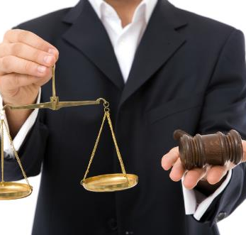
Laws Protecting Gender Identity & Expression and Sexual Orientation
Principal Laws
  Alberta Human Rights Act
  Canadian Charter of Rights
  and Freedoms
  Vital Statistics Act
Other Laws
  − Employment Standards &
  Labour laws
  − Health and Safety laws
  − Privacy laws
  − Laws applicable to specific
  industries or sectors

Slide 8
Laws Governing Human Rights of Federal Entities
Charter
Canadian Human Rights Act
CHRC Decisions
Court Decisions
Notes:
Federal human rights laws prohibit discrimination by federally regulated employers including employers in shipping, ferries, air transportation, railways, telephone, cable, radio and television, crown corporations and ferries.

Slide 9
Laws Governing Human Rights of Alberta Entities
Charter
Alberta Human Rights Act
AHRC Decisions
Court Decisions
Notes:
Alberta human rights laws prohibit discrimination by the Alberta government and its agents and private individuals and entities in Alberta.

Slide 10

Alberta Human Rights Act

Slide 11
Preamble - Alberta Human Rights Act
WHEREAS recognition of the inherent dignity and the equal and inalienable rights of all persons is the foundation of freedom, justice and peace in the world;
WHEREAS it is recognized in Alberta as a fundamental principle and as a matter of public policy that all persons are equal in: dignity, rights and responsibilities without regard to race, religious beliefs, colour, gender, gender identity, gender expression, physical disability, mental disability, age, ancestry, place of origin, marital status, source of income, family status or sexual orientation;

Slide 12
Alberta Human Rights Act
Alberta Human Rights Act, RSA 2000, c A-25.5, http://canlii.ca/t/5331 [AHRA]
ACLRC Annotated Alberta Human Rights – on ACLRC website under downloadable resources http://www.aclrc.com/downloadable-resources/
Federal & every provincial/territorial government has its own HR legislation
AHRA governs HR rights and duties of Alberta residents, businesses & government
Primacy legislation (i.e. takes precedence over other provincial laws)

Slide 13
Alberta Human Rights Act
5 Protected Areas
Alberta Human Rights Act
Publications
Employment
Unions + Occupational Associations
Tenancy
Services
Notes:
The Alberta Human Rights Act prohibits discrimination in 5 different areas – publications, services, tenancy, employment and unions/occupational associations

Slide 14
Alberta Human Rights Act
15 Protected Grounds
Grounds
Race
Religious belief
Colour
Gender
Physical Disability
Mental Disability
Marital Status
Age
Ancestry
Place of Origin
Family Status
Source of Income
Sexual Orientation
Gender Identity
Gender Expression
Notes:
The Alberta Human Rights Act prohibits discrimination on 15 grounds.

Slide 15
Alberta Human Rights Act Applies
Protected Grounds
Protected Areas
Human Rights Complaint
possible
Notes:
A human rights can be commenced if discrimination takes place in one or more of the 5 areas based on one or more of the 15 grounds.

Slide 16
Section 4 of the Alberta Human Rights Act
4. No person shall:
(a) deny to any person or class of persons any goods, services, accommodation or facilities that are customarily available to the public, or
(b) discriminate against any person or class of persons with respect to any goods, services, accommodation or facilities that are customarily available to the public,
because of the race, religious beliefs, colour, gender, gender identity, gender expression, physical disability, mental disability, age, ancestry, place of origin, marital status, source of income, family status or sexual orientation of that person or class of persons or of any other person or class of persons.
Notes:
Section 4 of the Alberta Human Rights Act recognizes that all people are equal in dignity, rights and responsibilities when it comes to provision of goods, services, accommodation or facilities customarily available to the public. In fact, most of our day-to-day public interactions are covered by Section 4 of the AHRA.

Slide 17
Section 7 of the Alberta Human Rights Act
7(1) No employer shall
(a) refuse to employ or refuse to continue to employ any person, or
(b) discriminate against any person with regard to employment or any term or condition of employment,
because of the race, religious beliefs, colour, gender, gender identity, gender expression, physical disability, mental disability, age, ancestry, place of origin, marital status, source of income, family status or sexual orientation of that person or of any other person.
……
(3) Subsection (1) does not apply with respect to a refusal, limitation, specification or preference based on a bona fide occupational requirement.
Notes:
Section 7 of the AHRA prohibits discrimination in employment.

Slide 18
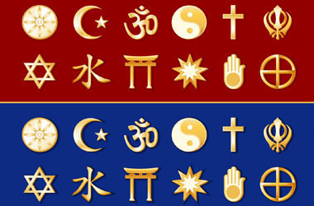
Alberta Human Rights Act
Duty to Accommodate

Slide 19
Duty to Accommodate
“Accommodation means making changes to certain rules, standards, policies, workplace cultures and physical environments to ensure that they don't have a negative effect on a person because of the person's mental or physical disability, religion, gender or any other protected ground.”
“gender” = “male, female or transgender”
AB Human Rights Commission Duty to Accommodate Interpretive
Bulletin at www.albertahumanrights.ab.ca
Notes:
Humana rights law requires that those covered by 5 areas governed by the AHRA must “accommodate” the needs of people who are protected under the 15 grounds under which discrimination is prohibited under the AHRA. What does “accommodate” mean?

Slide 20
Duty to Accommodate
Service providers, employers and other areas covered by the AHRA have a duty to accommodate “to the point of undue hardship”.
  Some hardship may be necessary
Consumers of services, employees and others covered under the AHRA have responsibilities as well.
  Working with the service provider or employer
  Notify service provider/employer of needs.
Notes:
The law states that individuals protected under the AHRA must be accommodated “to the point of undue hardship”. This means that consideration must be given to how individuals can be accommodated and that the entity accommodating must experience some hardship in order to provide accommodation.
The individuals wishing to be accommodated also have duties to identify their needs and work with those providing accommodation. Accommodation does not have to be immediate or perfect.

Slide 21

Undue Hardship
An employer has a duty to accommodate an employee to the point of undue hardship.
available resources
size of company
safety
disruption
interchangeability of workforce
other relevant factors
Notes:
The above factors will be taken into consideration in determining when accommodation has become undue.
When the accommodation causes the entity who must accommodate an undue hardship then it may decide to claim that the person seeking accommodation could not be accommodated.
However, there is no hard and fast rule as to what constitutes an undue hardship.
What is the financial cost?
What is the size of the company and what resources can the employer provide?
Will the accommodation involve a large disruption to operations?
Can the company interchange individual jobs in the workforce or assign the employee to a more suitable facility?
Are there any health and safety concerns?

Slide 22
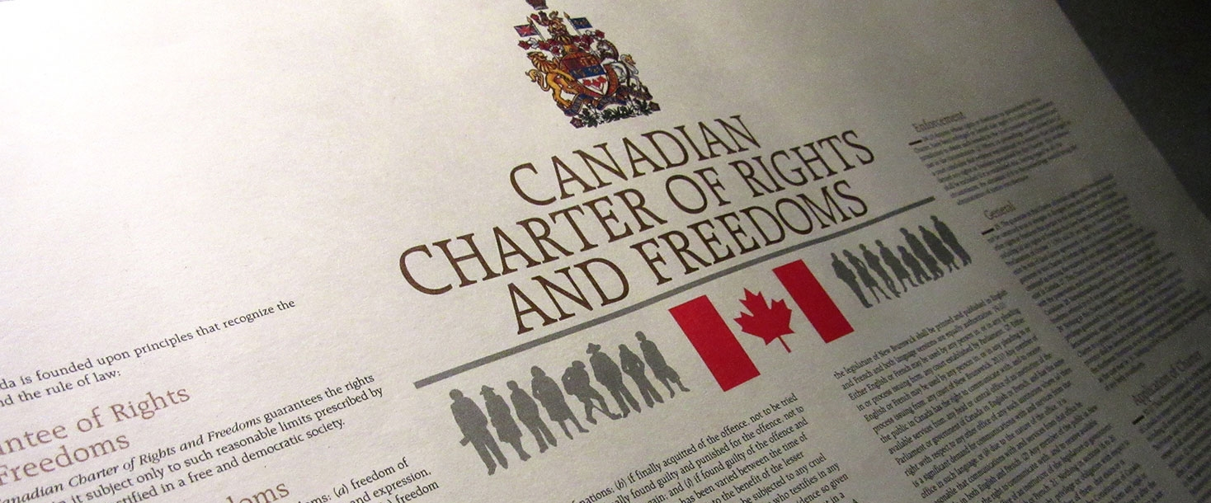
Notes:
The Charter of Rights and Freedoms binds governments and provides a check on government power. It applies, for example, when the government passes discriminatory legislation or acts in a discriminatory manner.

Slide 23
Seven Categories of Rights under the Charter
1. FUNDAMENTAL FREEDOMS [s 2]
2. DEMOCRATIC RIGHTS [ss 3 - 5]
3. MOBILITY RIGHTS [ss 6]
4. LEGAL RIGHTS [ss 7 - 14]
Life, liberty and security of person [s 7]
Treatment or punishment [s 12]
5. EQUALITY RIGHTS [s 15]
6. OFFICIAL LANGUAGES OF CANADA [ss 16 - 22]
7. MINORITY LANGUAGE EDUCATIONAL RIGHTS [ss 23 -24]
Notes:
Individuals are given rights under the above 7 areas under the Charter.

Slide 24
Human Rights Tribunal & Court Decisions
Numerous decisions challenging actions or decisions of organizations and governments based on violation of person’s gender or sexual orientation rights under the human rights legislation or the Charter
A summary of some of these cases can be found on the federal department of Public Services and Procurement Canada resource: “Support for trans employees: A guide for employees and managershttps://www.tpsgc-pwgsc.gc.ca/apropos-about/guide-et-te-eng.html#s43
Notes:
- Human rights laws also come from the decisions of human rights tribunals and the courts.
- In C.F. v Alberta (Vital Statistics), 2014 ABQB 237 (CanLII), Alberta's Director of Vital Statistics interpreted the Vital Statistics Act as requiring transgendered people to have gender confirmation surgery in order to be eligible to have the sex on their birth certificate changed. C.F., a trans female, challenged this interpretation as contrary to her rights under sections 7 and 15 of the Charter. In a ground breaking decision, Justice B.R. Burrows found in favour of C.F. and ordered the Director to issue C.F. a new birth certificate without proof of the surgery.

Slide 25

Harassment, Sexual Harassment & Discrimination
Notes:
Discriminatory or harassing comments made directly to someone who is receiving a service or in their employment are likely to be found discriminatory (Taylor-Baptiste v Ontario Public Service Employees Union, 2013 HRTO 180 (CanLII) at para. 31-32).

Slide 26
Harassment
Must be based on one or more of the 15 grounds (includes sex, sexual orientation, gender identity and gender expression)
Must occur in one or more of the 5 protected areas (includes provision of services and employment)
Unwanted / uninvited conduct
Verbal, physical, non-verbal
Intention to harass is not a factor in the definition
Often a power imbalance but not always
Notes:
Discrimination encompasses harassment.

Slide 27
Sexual Harassment
Physical Contact
  Touching, pinching, patting, kissing, fondling, groping, grabbing
  Suggestive/obscene notes, emails
  Physical assault (can be a criminal offence)
Verbal Harassment
  Slurs, jokes, derogatory comments
  Gossip about a person’s sex life or partners
  Sexually suggestive invitations
Non-verbal Harassment
  Leering in a sexually suggestive manner
  Displaying pornographic images
Notes:
What is sexual harassment?

Slide 28
Discrimination
R v Andrews (SCC) 1989
….a distinction, whether intentional or not but based on grounds relating to personal characteristics of the individual or group, which has the effect of imposing burdens, obligations, or disadvantages on such individual or group not imposed upon others, or which withholds or limits access to opportunities, benefits, and advantages available to other members of society.
Notes:
This is the definition of discrimination given by the above decision of the Supreme Court of Canada.

Slide 29
Elements of Discrimination
Distinction (differential treatment) that imposes burdens, obligations or disadvantages or withholds or limits access to opportunities, benefits, & advantages
Based on grounds relating to personal characteristics of individual/group = prohibited grounds under AHRA (i.e. gender, gender orientation or gender expression)
Burdens/disadvantages not imposed on persons/groups who do not have those personal characteristics
Notes:
Verbal, physical, non-verbal
Discrimination can take many forms
Verbal, something people say to you, or around you that creates a hostile work environment
It can also be physical, it can be touching, poking or at worst assaulting you. If it reaches that stage, it is a criminal matter as well but it is also discrimination.
It can also be non-verbal. It can be an informal policy, it can be posters on the wall that make you uncomfortable, it can be events that are planned only for certain staff members.

Slide 30
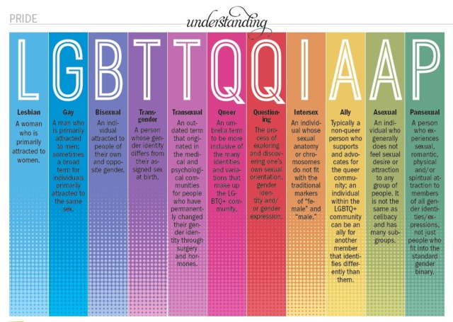
DEFINITIONS
Notes:
What do the above terms mean?
Public registries process applications that require that the gender or sex of a person be stipulated. Registry businesses and their agents are prohibited from denying or discriminating in the provision of services based on 15 grounds, including a person’s sexual orientation, gender identity, and gender expression. They must understand what these terms mean both to avoid discrimination and harassment and in order to understand how client’s applications for registration or amendments to registrations should be handled and how to respectfully deal with such applications from people in the LGBTQ+ community.

Slide 31
Sex
Medical classification of a person as male (M), female (F), or undetermined (U).
Registry classification of M, F, or X (undeclared).
Stats Canada classification of M, F, or I (Intersex).
IOC Olympic classification: testosterone above 10ng/dL, but only for one gender
Confused yet?
.
Notes:
Different entities define sex differently.

Slide 32
Gender
Gender has traditionally been assigned based upon the sex assigned at birth & restricted to classification as a “male” or “female” (binary gender).
Gender has a wider meaning than male or female and refers to the state of being:
  Male
  Female
  Transgender or
  Two-spirited (Aboriginal term that
  embodies male & female)

Slide 33
DEFINITIONS
Lesbian - “A woman who is emotionally, physically, spiritually and/or sexually attracted to women.”
Gay - “A person whose enduring physical, romantic, spiritual, emotional, and/or sexual attractions are to people of the same gender. The word can refer to men or women, although some women prefer “lesbian.” Sometimes used as an umbrella term for the LBGTQ community.”
Bisexual - “A person who is emotionally, physically, spiritually and/or sexually attracted to people of more than one gender, though not necessarily at the same time.”
Notes:
The definitions discussed are taken from The 519 Glossary. For a more extensive list, see The 519’s Glossary of Terms, facilitating shared understandings around equity, diversity, inclusion and awareness, online: http://www.the519.org/education-training/glossary
The term “homosexual” has been used as a derogatory term. The term “gay” is now used to refer to gay men and women.
These are some of the main terms used, but the terms are always evolving and changing. Recommend becoming familiar with the terms in The 519 Glossary.

Slide 34
DEFINITIONS
Trans or Transgender - “Umbrella terms that describe people with diverse gender identities and gender expressions that do not conform to stereotypical ideas about what it means to be a girl/woman or boy/man in society…It includes but is not limited to people who identify as transgender, transsexual, cross-dressers or gender non-conforming (gender variant or gender-queer).”
Transsexual – “A person whose gender identity differs from their sex assigned at birth. They may or may not undergo medically supportive treatments to align their bodies with their gender identity, such as hormone therapy, sex
confIrmation surgery or other procedures or changes.”

Slide 35
DEFINITIONS
Queer - “Formerly derogatory slang term used to identify LGBT people. Some members of the LGBT community have embraced and reinvented this term as a positive and proud political identifier when speaking among and about themselves.”
Questioning - “A period where a person explores their own sexual and/or gender identity, reflecting on such things as upbringing, expectations from others, and inner landscape. The person may not be certain if they are gay, lesbian, bisexual, or trans and may be trying to figure out
how to identify themselves.”

Slide 36
DEFINITIONS
Intersex – “A term used to describe a person born with reproductive systems, chromosomes and/or hormones that are not easily characterized as male or female. This might include a woman with XY chromosomes or a man with ovaries instead of testes. Intersex characteristics occur in one out of every 1,500 births. Typically intersex people are assigned one sex, male or female, at birth. Some intersex people identify with their assigned sex, while others do not, and some choose to identify as intersex. Intersex people may or may not identify as trans or transgender.”

Slide 37
DEFINITIONS
Ally – “A person who works to end a form of oppression that gives them privilege(s). Allies listen to, and are guided by, communities and individuals affected by oppression. Forms of oppression include: able-ism, ageism, audism, classism, biphobia, homophobia, transphobia, racism, sexism, and others.”
Assexual – “A sexual orientation where a person experiences little or no sexual attraction.”

Slide 38
DEFINITIONS
Pansexual – “A person who has the potential for romantic and sexual attraction to people of any gender or sex.”
Cisgender – Another term “used to explain the phenomena where a person’s gender identity is in line with or “matches” the sex they were assigned at birth. Cis can also be used as a prefix to an assortment of words to refer to the alignment of gender identity and the assigned at birth sex status including; cisnormativity, cissexual, cisgender, cis male,
and cis female.”

Slide 39
DEFINITIONS
Two-Spirit - “A term used by Indigenous People to describe from a cultural perspective people who are gay, lesbian, bisexual, trans, or intersex. It is used to capture a concept that exists in many different Indigenous cultures and languages. For some, the term two-spirit describes a societal and spiritual role that certain people played within traditional societies; they were often mediators, keepers of certain ceremonies; they transcended accepted roles of men and women, and filled a role as an established middle gender.”

Slide 40
Sexual Orientation
Sexual orientation refers to sexual attraction or lack thereof and includes persons who are:
  heterosexual
  lesbian or gay
  bisexual
  Pansexual
  asexual
It may be more helpful to use the terms:
  Gyneophillic - attraction to femininity
  Androphillic – attraction to masculinity

Slide 41
Gender Identity
A person’s internal and individual experience of gender, which includes the sense of being a woman, man, both, neither, or anywhere along the gender spectrum.
A person’s gender identity may be the same as or different from the sex or gender they were assigned at birth.
Terms referring to one’s gender identity are wide-ranging and evolving and include the terms trans, queer, two-spirited.
Notes:
A person’s gender identity is fundamentally different from and not related to their sexual orientation.

Slide 42
Gender Expression
  How a person publicly expresses or presents their gender including behaviour and outward appearance such as dress, hair, make-up, body language and voice.
  Name and pronouns are also common ways of expressing gender.
  All people, regardless of their gender identity, have a gender expression and they may express it in any number of ways.

Slide 43
Jurisdiction | Gender Neutal Designation | Identification Documents Affected
BC | No | Denied & being litigated
AB | Yes | DL, Birth Cert; Health
Sask | No
Man | No
Ont | Yes
Que | No
NS | No
NB | No
PEI | No
Nfld/Lab | Yes
NWT | No
Yukon | No
Nunavut | No
Notes:
Gender Identify and Sexual Orientation are unrelated. One’s gender identity does not necessarily dictate their sexual orientation.
BC – BC resident, Joshua Ferguson, whose designation is M but does not identify as M or F, denied non-binary gender designation “X” on BC health card and driver’s licence. BC baby born outside health care system (& therefore not given sex designation) issued health card with sex designation “X” & parent seeking judicial review of BC’s refusal to issue birth cert with “U”.

Slide 44
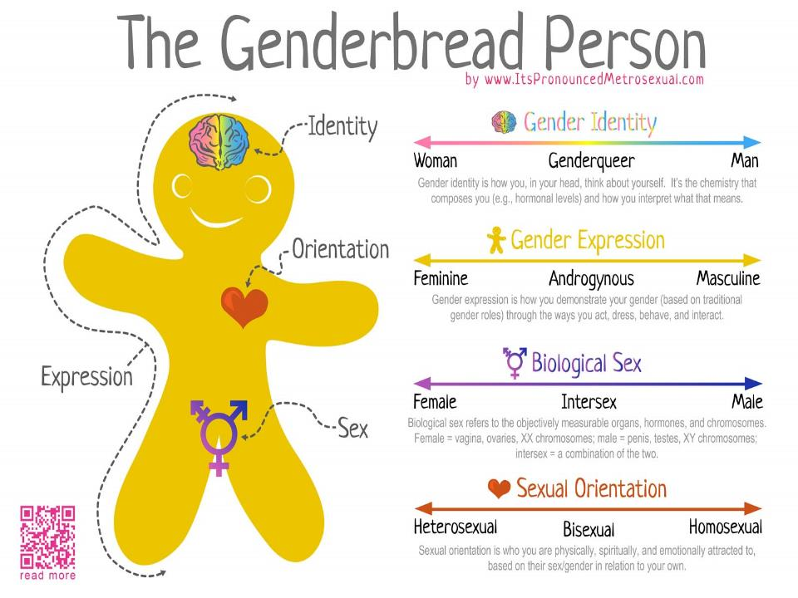
Notes:
The Genderbread Person is a handy guide to introducing the concept that these variables are not 100% linked.

Slide 45
Names, Pronouns & Prefixes – Why is proper use important?
Personal names and pronouns are two fundamental ways we express gender and how others perceive our gender. Traditional gender pronouns (she/her, he/him) do not fit everyone’s gender identity.
Words describe who we are. The right terms can affirm identities and challenge discriminatory attitudes. The wrong words can disempower, demean and reinforce exclusion.
Notes:
The acceptance and use of non-binary gender pronouns like “they” is as important as it was, during the evolution of the feminist movement, to transition to the use the title “Ms” or use a married woman’s maiden name.

Slide 46
Is it illegal to refuse to use gender neutral pronouns?
The Ontario Human Rights Commission resource “Questions and answers about gender identity and pronouns”states:
“The law recognizes that everyone has the right to self-identify their gender and that “misgendering” is a form of discrimination….
Refusing to refer to a trans person by their chosen name and a personal pronoun that matches their gender identity, or purposely misgendering, will likely be discrimination when it takes place in a social area covered by the Code, including employment, housing and services like education. The law is otherwise unsettled as to whether someone can insist on any one gender-neutral pronoun in particular.”
The OHRC cites Dawson v Vancouver Police Board (No. 2), 2015 BCHRT 54 (CanLII) wherein the BCHRT found misgendering to be discriminatory in a case involving police, in part because the police used male pronouns despite the complainant’s self-identification as a trans woman.
The Ontario Human Right Commission
Notes:
See OHRC http://www.ohrc.on.ca/en/questions-and-answers-about-gender-identity-and-pronouns

Slide 47
Pronouns
How to pronounce gender neutral pronouns:
 | Subject | Object | Possessive Adjective | Possessive Noun | Reflexive
Female | She | Her | Her | Hers | Herself
Male | He | Him | His | His | Himself
 | They | Their | Their | Theirs | Themself
Gender Neutral | Ze | Hir | Hir | Hirs | Hirself
Spivak | E | Em | Eir | Eirs | Emself
Ze | Hir | Hirs | Hirself | E | Em | Eir | Eirs | Emself
Zee | Here | Heres | Hereself | ee | em | air | airs | emself
Notes:
Above terms obtained at http://web.mit.edu/trans/GenderNeutralPronouns.pdf.
The gender-neutral and Spivak terms above are most commonly used by academics studying in this area or in specific online sites but it is not expected that service providers or others covered by the Alberta Human Rights Act will know or use them.
Many languages do not have gendered pronouns, or they are used less frequently (ASL, Japanese, Persian, Farsi, Finnish “hän”, etc)
Using the correct pronoun is an important sign of respect, and important in establishing trust.
Introducing yourself with your pronouns is a big signal that you are aware and open to hearing someone else’s pronouns.
Generally, when in doubt, ask a person how they wish to be addressed. Use “they” if you don’t know which pronoun is preferred. Simply referring to the person by their chosen name is always a respectful approach.

Slide 48
Examples of How to Use Pronouns
She went to her bedroom……He went to his bedroom.
Ze went to hir bedroom……….E went to eir bedroom.
I am her sister…………………….I am his sister.
I am hir sister……………………..I am eir sister.
She shaves herself……………… He shaves himself.
Ze shaves hirself……….…………E shaves emself.

Slide 49
Identifying one’s pronouns
“They” is a commonly used pronoun to describe someone who does not want to use traditional he/she her/him pronouns.
Alex is coming for lunch. They just went to get their wallet.
Consider identifying your pronoun on your nametag at conferences.

Slide 50

Identity Documents
41% of people in transition don’t have identity documents reflecting their gender.
Amendments to the Alberta Vital Statistics Act made through the enactment of the Vital Statistics and Life Events Modernization Act will change that.
Notes:
In 2016, the Alberta government enacted the Alberta Vital Statistics and Life Events Modernization Act (VSLEMA), which amends the Vital Statistics Act, the legislation that governs how the government collects and registers information about the life events of Alberta residents - births, marriages, adoptions and deaths - that are essential for obtaining legal documents used to verify people’s identity, such as birth certificates, Alberta Identification cards and driver’s licences.

Slide 51
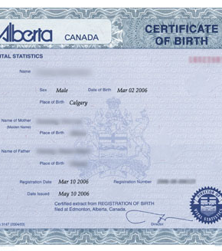
Identifying/Changing Name, Sex & Gender on Identity Documents
Change of Name
Sex or Amendment of Sex
Gender or Amendment of Gender
on identity documents:
  Record of Birth
  Birth Certificate
  Stillbirth
  Adoption Certificate
  Marriage Licence
  Driver’s Licence
  Alberta Identification Cards
  Death Certificate

Slide 52
Amendments to the Vital Statistics Act
The Vital Statistics Act governs how the government collects and registers information about the life events of Alberta residents such as births, adoptions, marriages, and deaths – information essential for obtaining legal documents used to verify people’s identity
In 2016, the Vital Statistics and Life Events Modernization (VSLEMA) was enacted to amend the Vital Statistics Act, including provisions amending how gender is identified. Certain provisions were not proclaimed in force to allow the government and other entities that deal with this information, such as Alberta Registry Agents, to prepare for the changes.
On June 8, 2018, the Alberta government proclaimed provisions in the VSLEMA in force which amends the Vital Statistics Act.

Slide 53
Changes to the Vital Statistics Act Affecting Gender
Provide individuals who do not identify as male (M) or female (F) the choice of selecting a gender-neutral marker such as “X” on vital records. This will allow transgender individuals to chose to register non-binary (neither male or female) gender on Alberta legal documents (e.g. birth certificates) & will also align with changes to federal laws allowing Canadians to select “X” as a gender marker on passports.
Remove the outdated requirement for proof-of-sex re-assignment surgery to change one’s sex on vital records.
Expand the list of professionals who may confirm an
applicant’s affidavit for change of sex to include
registered social workers, nurse practitioners and registered nurses.
Notes:
See Service Alberta summary at https://www.servicealberta.ca/3188.cfm

Slide 54
Changes to the Vital Statistics Act Affecting Name Changes
Clarify that parents may choose any last name for their child
Remove requirement to publish legal change of name in the Alberta Gazette.
Remove requirement to provide a reason for requesting a legal change of name.
Make it easier for individuals born outside Canada to change their name, by allowing more documents to be accepted as proof (currently only permanent resident or citizenship cards are accepted).
Increase age when child’s given name may be amended without supporting documentation (from 10 years to 12 years).
Simplify consent requirements for legal change of
name for a minor.
Notes:
Allowing parents to choose any last name lets parents embrace traditional and cultural naming conventions, for example, placing the family name before the given name. Name changes are restricted to avoid inappropriate names.

Slide 55
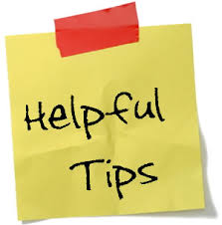
Strategies For Change
If unfamiliar with gender terms used, ask respectfully
Listen to, use and respect the names, pronouns and title a person uses
Use “they” when appropriate
Ask yourself
  Why am I asking this question?
  Do I need to know their gender?
  Would I ask someone who is not LGBTQ2S+ this question?”
Be aware of diversity
Don’t make assumptions
Do not jokes related to
being LGBTQ2S+
Review and amend
policies
Notes:
If unfamiliar with gender terms a person uses, ask respectfully “What does that term mean to you? & “what you I do to respect you in interactions”.
Be conscientious about using the language that someone uses to identify themselves including using the right name and pronouns at all times. This applies to reporting or referring to anytime in someone’s life – past present or future. Avoid saying “preferred” – they just are. Use and respect gender-neutral pronouns such as they/them and titles (Sir, Ms., Mx., etc.) if these are what someone uses. In case you were wondering, it is grammatically correct to use “they” as a singular pronoun.
Don’t make assumptions. For instance, people who cross-dress and/or do drag don’t necessarily identify as trans.

Slide 56
Some Resources
Alberta Civil Liberties Research Centre, 403-220-2505, LGBT Resources, http://www.aclrc.com/lgbt/
Trans Equality Society of Alberta – www.tesaonline.org
Alberta Trans – www.AlbertaTrans.org
OUTreach Southern Alberta - http://www.outreachsa.ca/resources
National Center for Transgender Equality (US) - www.transequality.org
Calgary Outlink – Calgary LGBTQ centre - www.calgaryoutlink.ca
Youthsafe.net - Youthsafe.net provides links to information and resources, in Alberta, for lesbian, gay, bisexual and trans (“LGBT”) people and allies. The website is focused on services for youth and young adults.
The Rainbow Pages (Edmonton) - https://www.the-family-centre.com/rainbow-pages/
Institute for Sexual Minority Studies and Services (ISMSS) - www.ismss.ualberta.ca
The 519, City of Toronto LGBTQ Non-Profit, and Rainbow Health Ontario, Media Reference Guide - Discussing trans and gender-diverse people, online: http://www.the519.org/news/media-reference-guide-discussing-trans-and-gender-diverse-people
The 519’s Glossary of Terms, facilitating shared understandings around equity, diversity, inclusion and awareness, online: http://www.the519.org/education-training/glossary

Slide 57
Frequently Asked Questions

Slide 58
Frequently Asked Questions
Question: What if the duty to accommodate a person protected under human rights legislation conflicts with my own beliefs, for example, my religious beliefs?
Answer: Human rights law protects against discrimination based on gender identity, gender expression and sexual orientation as well as freedom of religion, for example. The balancing of these rights is a complex legal issue. However, the general view is that when an organization is providing a public service, especially when it is a service that must be provided by the government, as is the case with Alberta registry services, it is discriminatory to refuse to provide the service because it conflicts with
a person’s religious or other personal beliefs.

Slide 59
Marriage Commissioners Appointed Under The Marriage Act (Re), 2011 SKCA 3 (CanLII)
In this case the Saskatchewan Court of Appeal ruled that marriage commissioners who are public servants cannot refuse to marry same-sex couples.
The decision rejected two proposals from the provincial government to allow some or all marriage commissioners to refuse to perform a service involving gay or lesbian partners if it offended their religious beliefs.
The court noted that marriage commissioners are appointed by the government to perform non-religious ceremonies and are the only option for some same-sex couples seeking to marry. The Court stated that “the Supreme Court has repeatedly confirmed that freedom of religion is not absolute and that, in appropriate cases, it is subject to limitation…This is clearly one of those situations where religious freedom must yield to the larger public interest."

Slide 60
Frequently asked questions
Question: How do I know what questions I can ask of a person regarding their gender identity while still being respectful?
Answer: Identify the information you require in order to provide the services someone is seeking. Most ID requires specification of gender. It is not discriminatory, but informative, to advise customers what information they are required to provide in order to be provided with the identity documents they need. But it is important to be respectful by addressing people using the pronouns that are
consistent with their gender identity and gender
expression.

Slide 61
Frequently asked questions
Question: I wish to show respect for people’s gender identity or expression by using the pronouns they prefer but sometimes I forget, or use the wrong pronouns while talking to someone else in the office. What do I do?
Answer: If you choose to ask a person what pronouns they use, ask everyone, otherwise you single out some people as somehow non-conforming while not singling out others. If you make a mistake, apologize quietly and go on. If you are talking to someone else about the customer’s matter, use the terms “they” and “them” and “their”. These are already accepted and grammatically correct terms. Or refer to the person
as your “customer” or by their first name.

